Slide 1
A Civic and Social Services Internship Report On Pratibha Foundation NGO Working for Children And Women Welfare
DEV PATEL
22BCP185

Slide 2
CHAPTERS
Chapter 1: Introduction and Aims 6 Chapter 2: NGO: Aims and Objectives 7 Chapter 3: Activities at NGO 8
Chapter 4: Major Societal Problems Encountered
Chapter 5 : Methodology to Solve Societal Problems Chapter
Conclusions

Slide 3
Chapter 1: Introduction and Aims

Slide 4
Introduction
INTERNSHIP UNDER : PRATIBHA FOUNDATION, VADODARA - a unique platform provided by them to youth and kids as well as for Women Empowerment for the upliftment of society
INTERNSHIP DATE : 26th June to 9th July 2023
MAIN PROJECTS OF PRATIBHA FOUNDATION :
SKY-School for kids by youth
SWAA-Self welfare women association
This report is mainly focuses on pointing out the social issue in DENA VILLAGE (near Vadodara)
It also includes the reason by which the problems arises, how can we help them and what necessary steps to be taken to solve the issue under the SKY project
As we are aware that in India there are still a lot of villages which are yet to be developed. Through their grassroots programs, they are building a society where no child is deprived of education under the Pratibha foundation

Slide 5
AIMS
Learning and Skill Development
Exposure to NGO Operations
Professional Development
Contribution to the Organization's Mission:
Networking and Building Relationships
Cultural Exchange and Global Understanding:
Career Exploration and Decision-making
Social Impact and Personal Growth

Slide 6
Chapter 2: NGO: Aims and Objectives

Slide 7
AREAS OF GROWTH

Slide 8
Chapter 3: Activities At NGO

Slide 9
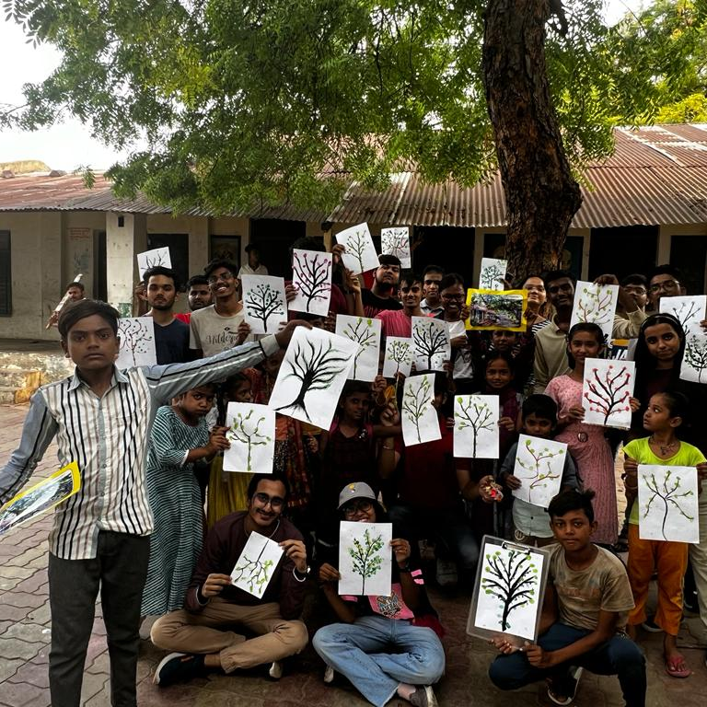
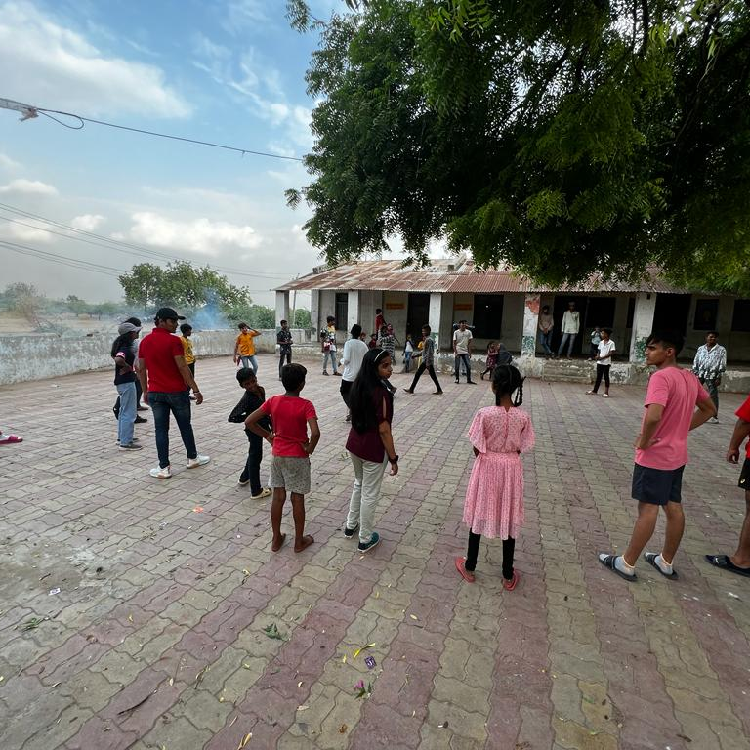
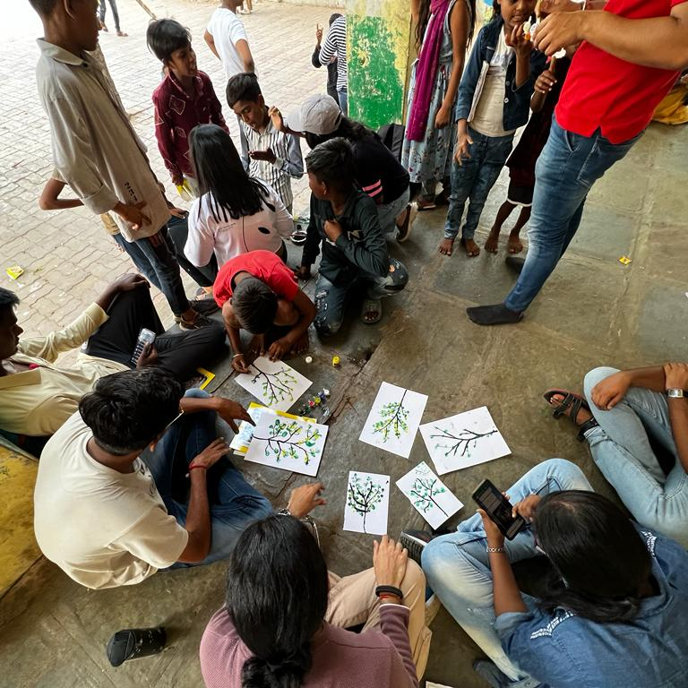
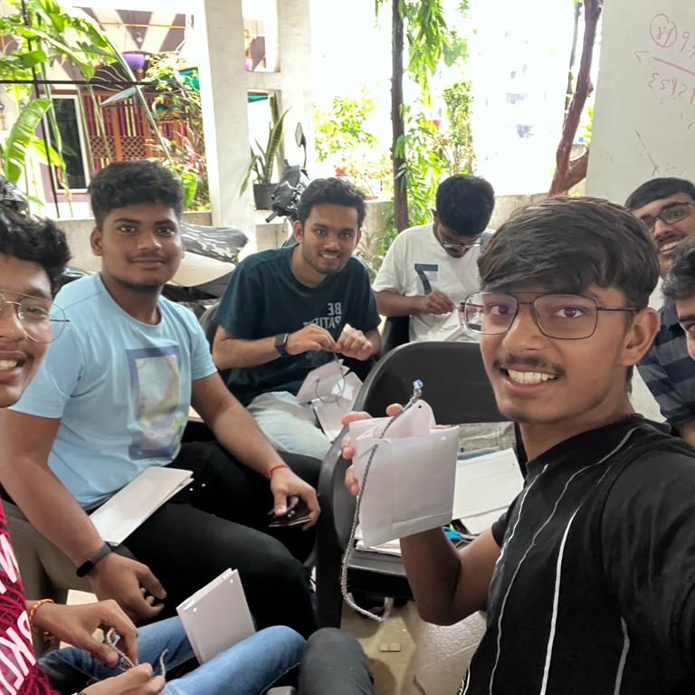
In NGO we conducted various activities with kids. We also noticed that kids enjoy painting, they are very creative in terms of artistic work. So we decided to do some artistic work with them and everyone participated in it very actively.
DRAWINGS MADE BY STUDENTS
PLAYING WITH KIDS
TEACHING STUDENTS
CRAFT WORK WITH THEM

Slide 10
Chapter 4: Major Societal Problems
• Dealing and spending a few days with those village kids the major problem which we encountered was that watching the children eating ‘Meethi Supari’, ‘Vimal’ and many other addictive things which are injurious to health and seeing such small kids doing so and also influencing the children younger than them to do so was really heartbreaking. They were also proud of doing such things. When we told them to stop these things and explained them how these things can harm them and even asked them the reason of eating such things then they just replied “It’s our pleasure and we will continue eating these things”. Well according to me this is really a problem should be taken in concern.
• Another problem seen was that the children had lack of knowledge of English which in todays world can take them towards higher risk with rising competitions.

Slide 11
Chapter 5 : Methodology to Solve Societal Problems Chapter
• According to me to solve the problem we should conduct a “ANTI TOBBACO PROGRAM” which could help the young minds understand how badly they are playing with their bodies and causing harm to themselves. In this program we can include ‘Dramas and plays’ spreading awareness. Along with this we can also conduct a short film program related to this.
• For English they should be provided extra English classes so that they can learn and grow with the competitive world.

Slide 12
CONCLUSION
CONCLUSION “These 15 Days”…Days of new learnings , new interactions , new bonds , new friendships. This internship taught us many things . The children of DENA VILLAGE accepted us whole heartedly it wasn’t as difficult as we thought would be interacting with them . They respected us , obeyed us but sometimes also demanded to do things as per their wish . A different type of bond was created with them during this period . Sometimes they even amazed us with their acceptance level how they accepted each others religion . They cared for each other and they even cared about us whether we are comfortable or not , just the bad thing we noticed about the children mainly the elder boys was their attractiveness towards the ‘TOBBACO’ , which I think should be taken in concern and necessary steps should be taken to explain then it’s harmful effect.

Slide 13
THANK YOU
DEV PATEL
22BCP185

